Slide 1




MedDetectives
DEPARTMENT OF INFORMATION TECHNOLOGY
Disease Prediction with Machine Learning
NARULA INSTITUTE OF TECHNOLOGY
Team :
Ankita Mitra NIT/2021/1296
Kabita Singh NIT/2021/1424
Ranjit Kumar Yadav NIT/2021/1375
Tamal Barman NIT/2021/1486

Slide 2

MOTIVATION
OBJECTIVES
INTRODUCTION
ALGORITHMS
IMPLEMENTATION
MODEL DIAGRAM
PREDICTIVE MODEL
TECHNOLOGY USED
OUTCOMES FROM OUR PROJECT
FUTURE PLANNING
CONCLUSION
Content
Outline
Topics for discussion
DISEASE PREDICTION WITH MACHINE LEARNING

Slide 3

What motivate us?
-> Less availability of Doctors
-> Less availability of Medicine Shop
-> Distance of Health Centre
-> Awareness of Diseases sitting at home
DISEASE PREDICTION WITH MACHINE LEARNING

Slide 4

Objectives
-> Our main aim is to provide a quick medical diagnosis to the patients.
->The goal is to provide access to medical specialists.
->This system enhance quality of health care.
DISEASE PREDICTION WITH MACHINE LEARNING

Slide 5

Introduction
->The main goal of our project is to provide the disease name by taking the symptoms from the user or patients.
Nowadays everything is available on the internet, so we thought of predicting the disease based on the symptoms that are given by the customer online.it is an interactive system that takes symptoms from the customer. the customer has to provide a minimum of 2 or 3 or more symptoms that they are suffering from.
->The purpose of this system is to predict disease and controlling the disease by providing accurate and trustworthy disease risk prediction.
DISEASE PREDICTION WITH MACHINE LEARNING

Slide 6

Algorithm
Machine Learning and it’s algorithms.
·Machine learning use programming algorithms that learn and optimize their operations by analysing input data
To make predictions withing an acceptable range. Machine learning algorithms they can be divided into three broad categories according to their purposes. There four categories
Are: supervised, unsupervised, semi-supervised. reinforcement.
·In supervised machine learning algorithms, a labelled training dataset is used first to train the underlying algorithms. This trained algorithm is then fed on the unlabelled test dataset to categories them into similar groups.
·For disease prediction the learning model include Linear Regression, Support Vector Machine, Decision Tree, Random Forest, Naïve Bayes, k-nearest neighbour, Artificial Neural Network etc.
DISEASE PREDICTION WITH MACHINE LEARNING
ARAICO PHARMACEUTICAL | VACCINES

Slide 7

Implementation
Data preparation is the primary step for any machine learning problem. We will be using a dataset from Kaggle for this problem.
Gathering the Data
Cleaning the Data
Model Building
Inference
DISEASE PREDICTION WITH MACHINE LEARNING

Slide 8






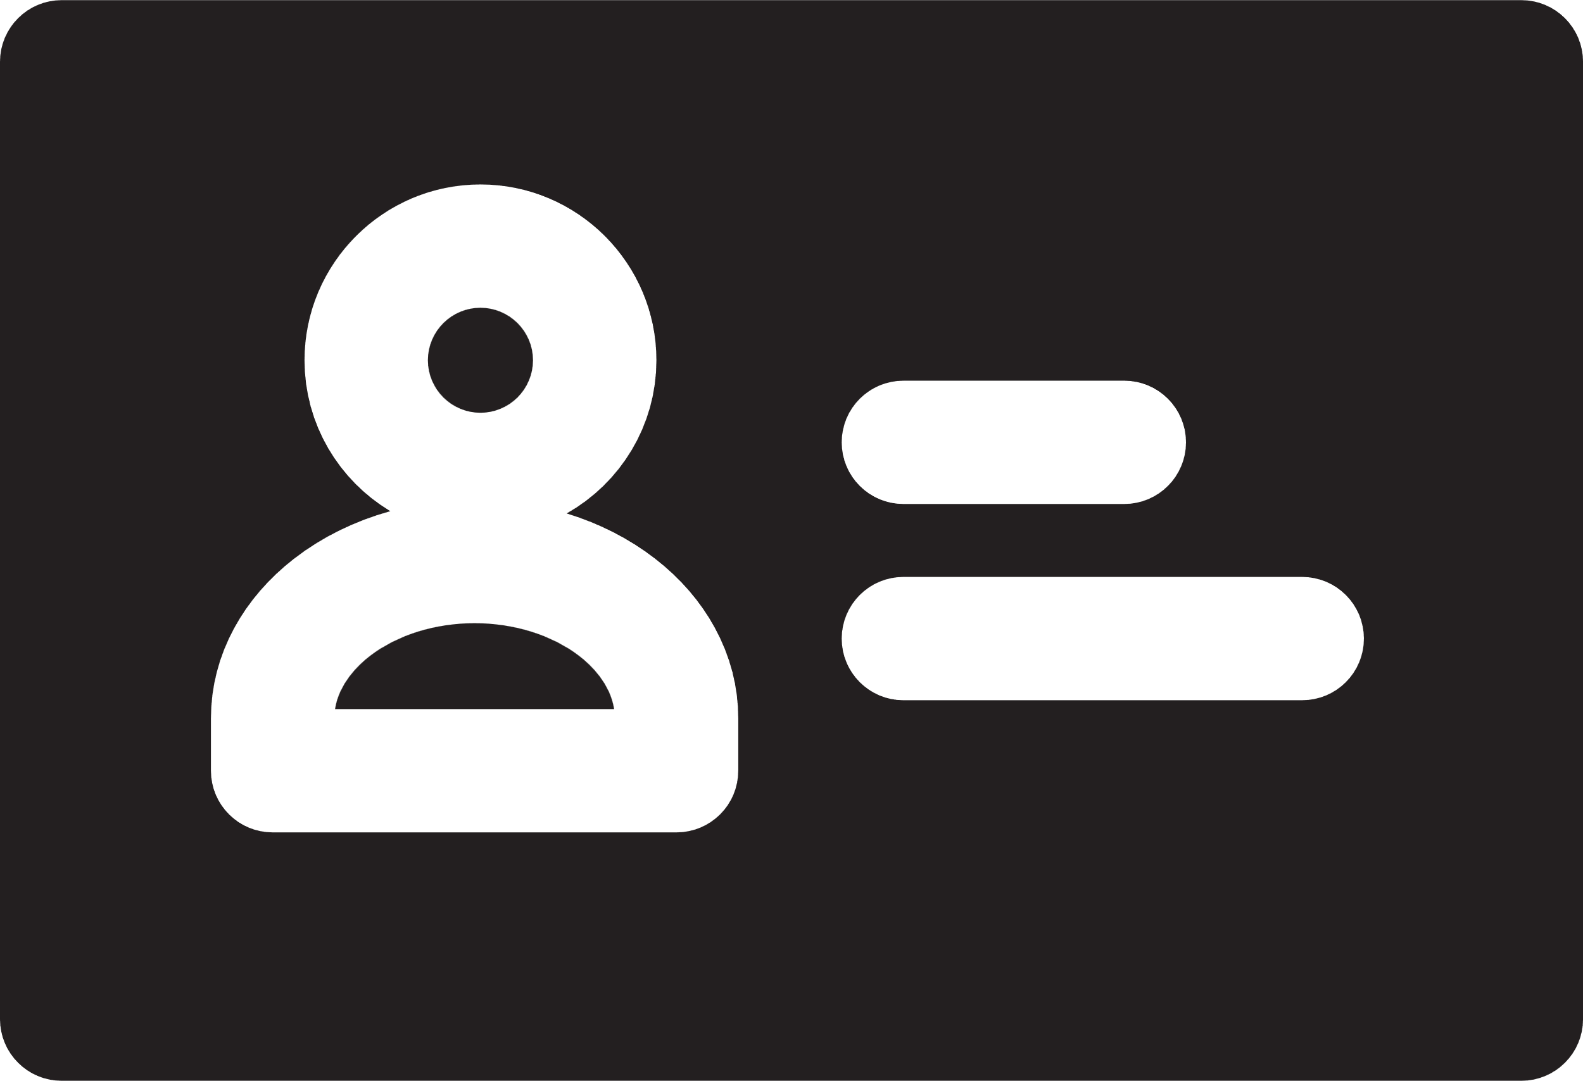
Model Diagram
Training Data
Data Transformation
Processed Data
ML Algorithms
User Data
User Symptoms
Prediction Model
Result
DISEASE PREDICTION WITH MACHINE LEARNING

Slide 9
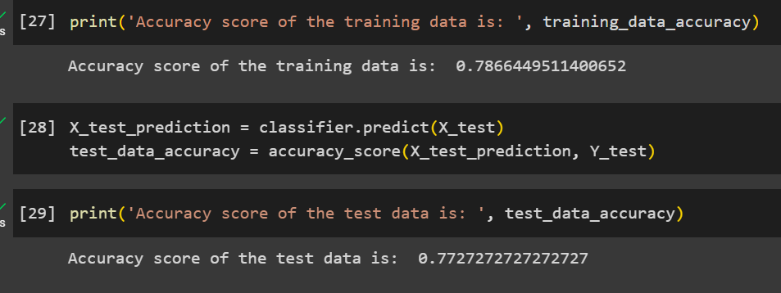
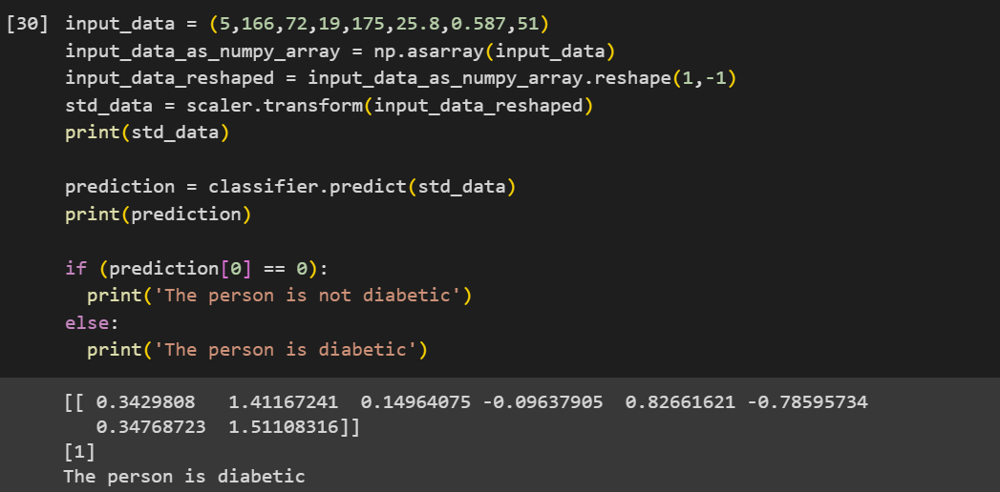
Diabetes Prediction
Accuracy
Result

Slide 10
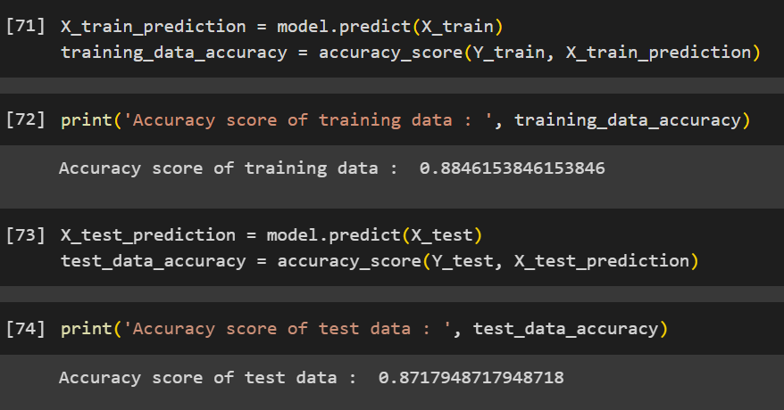
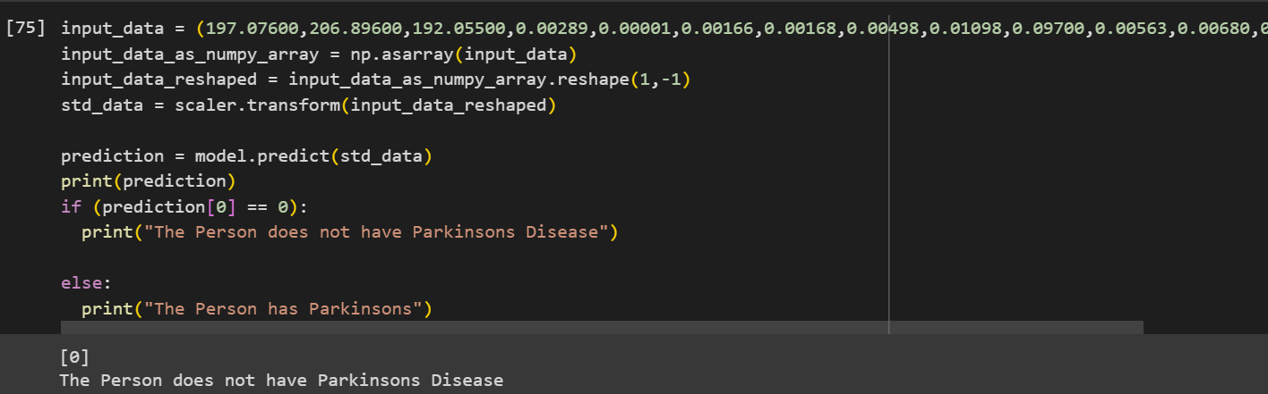
Parkinsons Prediction
Accuracy
Result

Slide 11
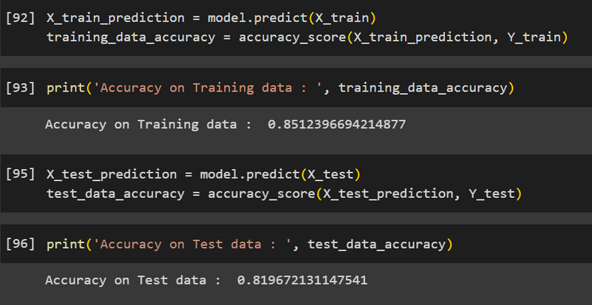
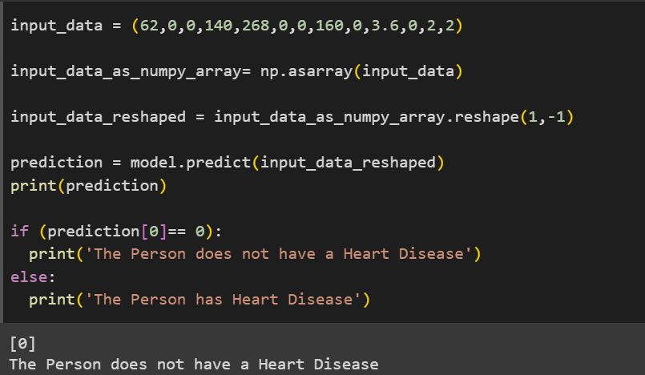
Heart Disease Prediction
Accuracy
Result

Slide 12
Technology helps
Anaconda
NumPy
Seaborn
Pandas
Scikit Learn
MatplotLib
Jupyter
Streamlit
DISEASE PREDICTION WITH MACHINE LEARNING

Slide 13
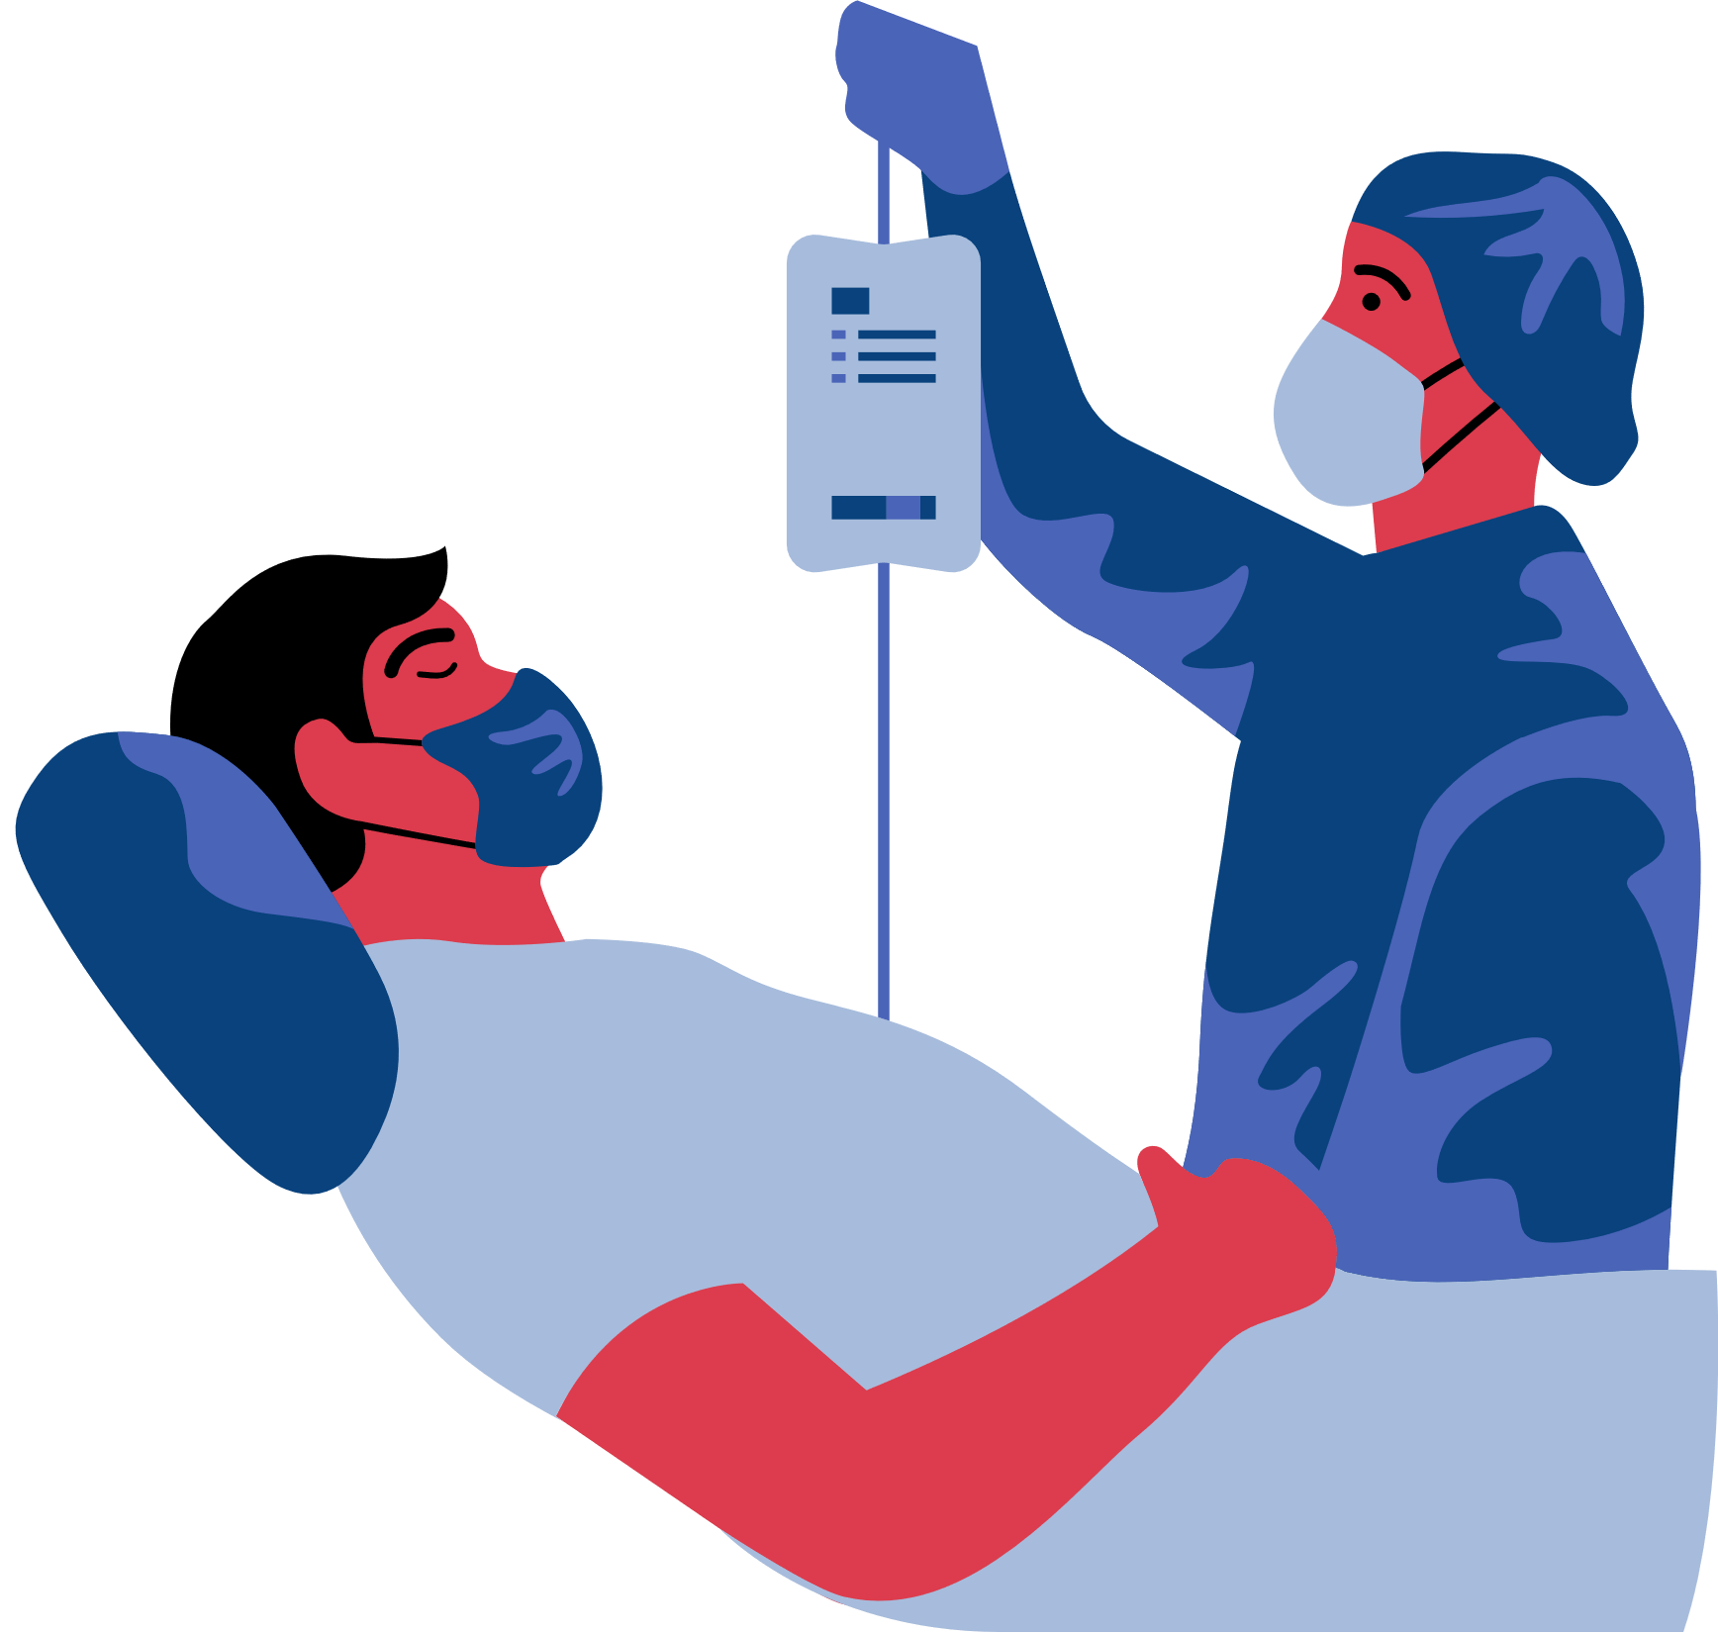

Outcomes from our project
•People will get to know about their diseases just sitting at home.
•Full information
•Multiple disease predictive model will be there
DISEASE PREDICTION WITH MACHINE LEARNING

Slide 14


Future Scope
•Near Hospital
•Available Doctors
•Nearest Medicine shop with map directions.
•Live consult with Doctors
DISEASE PREDICTION WITH MACHINE LEARNING

Slide 15
Conclusion
Our Project has the potential to revolutionized health care. Machine Learning Algorithm can be trained to analyse large amount of patient data and identified pattern and that may indicate the presents of a particular daisies. This projects will analyse large dataset of medical records and genetic data to identify pattern and generate predicated model.
But there are still challenges to overcome in term of data privacy and ethical considerations but with continued research and development diseases predication with machine learning has the potential to greatly improved the quality of health care and save countless life
DISEASE PREDICTION WITH MACHINE LEARNING

Slide 16
Thank you

